Slide 1
Brandermill Community Association
Master Plan Committee and BCA 2011 Activity

Slide 2
MPOC and BCA
Projects
  1. New Logo /Branding - Marketing
  2. Directional Signs - Marketing
  3. Entrance Landscaping – Community Character
  4. Community Clean Up Day - Activities
  5. The Landing - Natural Resources
  6. Nuttree Park – Natural Resources
  7. North Beach Pocket Park - Facilities
  8. Trail Review - Facilities
  9. Cluster Mail Boxes - NRC
  10. Harbour Pointe Clubhouse - BCA

Slide 3
New Logo/Branding -
Marketing Committee
A Waterfront Community – To be used on all new signs at entry points for Brandermill
  Hull Street Sign

Slide 4
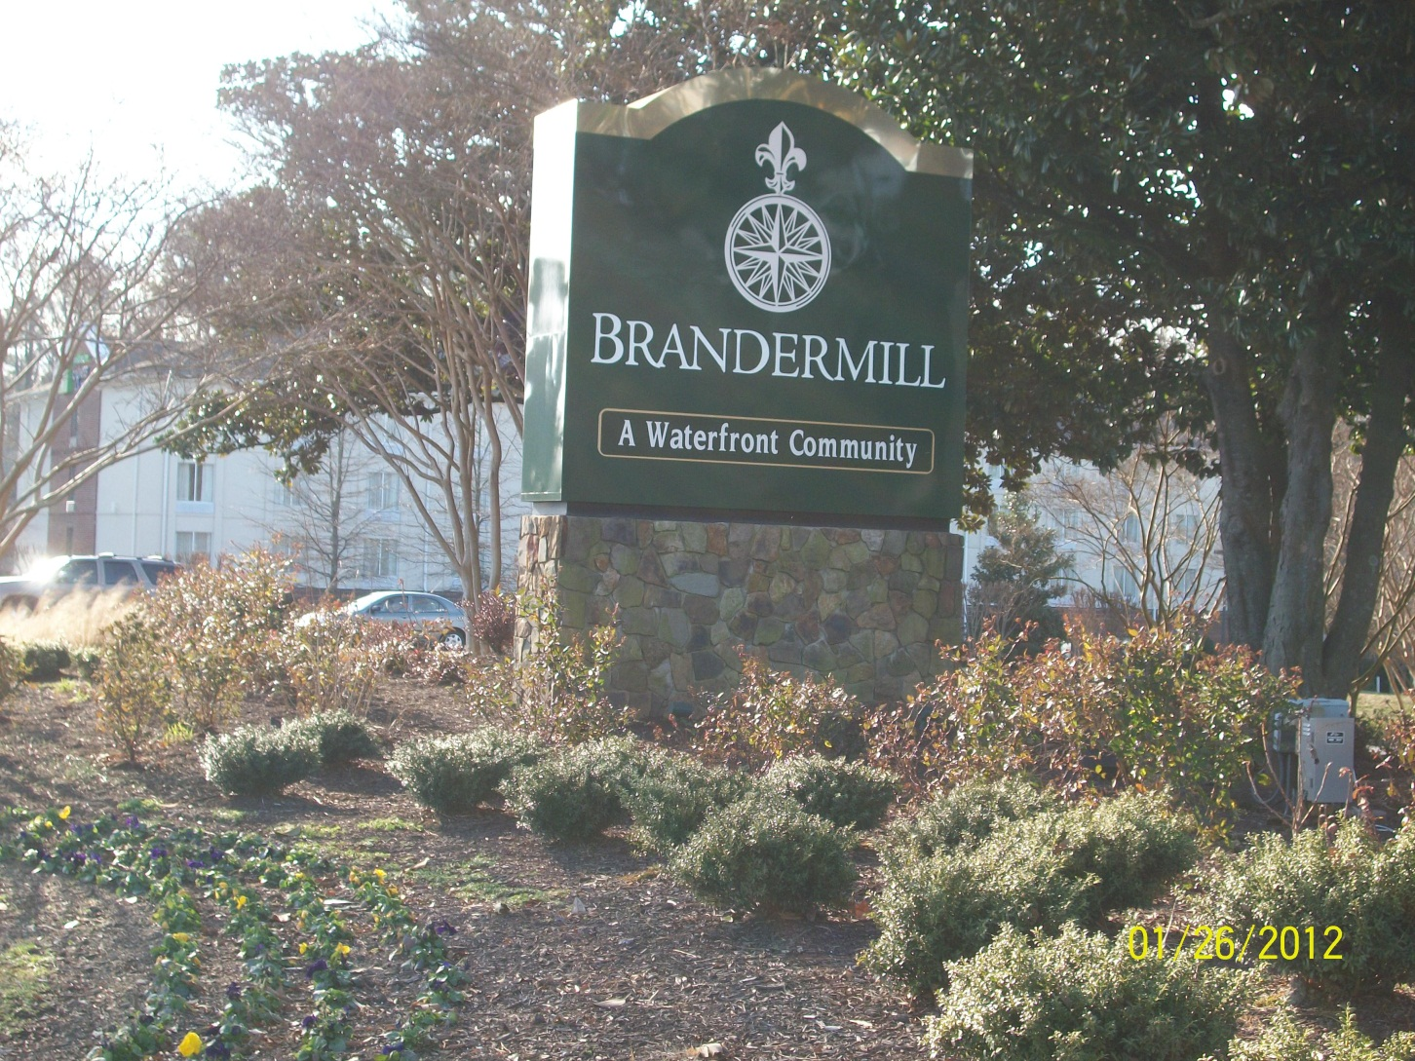
New Logo/Branding

Slide 5
Directional Signage –
Marketing and Community Character
Nine signs replaced
  Two on E. Boundary Terrace- BCA offices
  Two on Millridge Parkway – near Sunday Park
  Four on Brandermill Parkway north of Genito
  One at Brandermill Parkway and Millridge Parkway, near Golf and Tennis Clubs

Slide 6
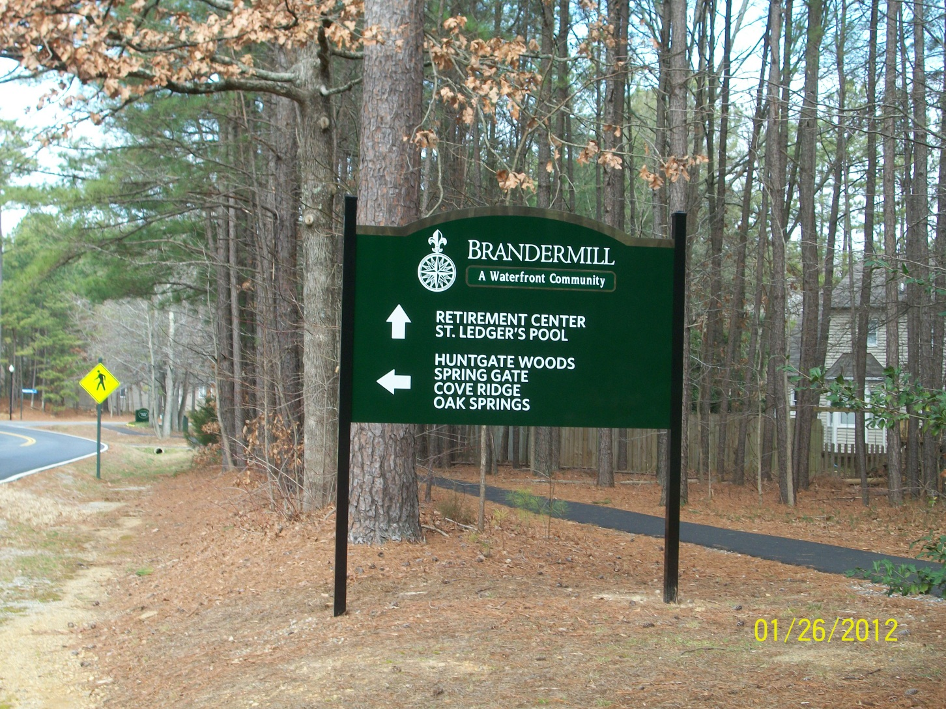
North Brandermill Parkway

Slide 7
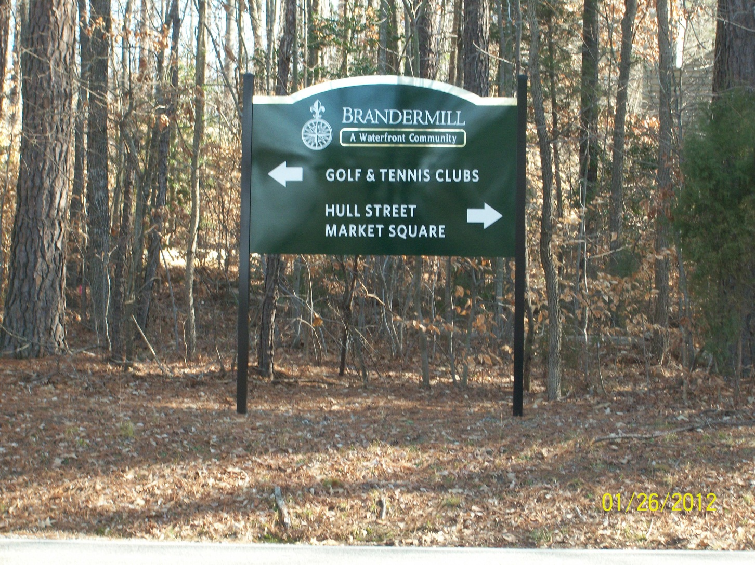
Sunday Park
Loop Road

Slide 8
Entrance Landscaping –
Community Character Committee
Five areas with enhanced landscaping
  Hull Street and Old Hundred entrance
  Old Hundred median strip
  Old Hundred and Millridge Parkway
  Millridge Parkway Entrance islands
  North entrance - Brandermill Woods

Slide 9
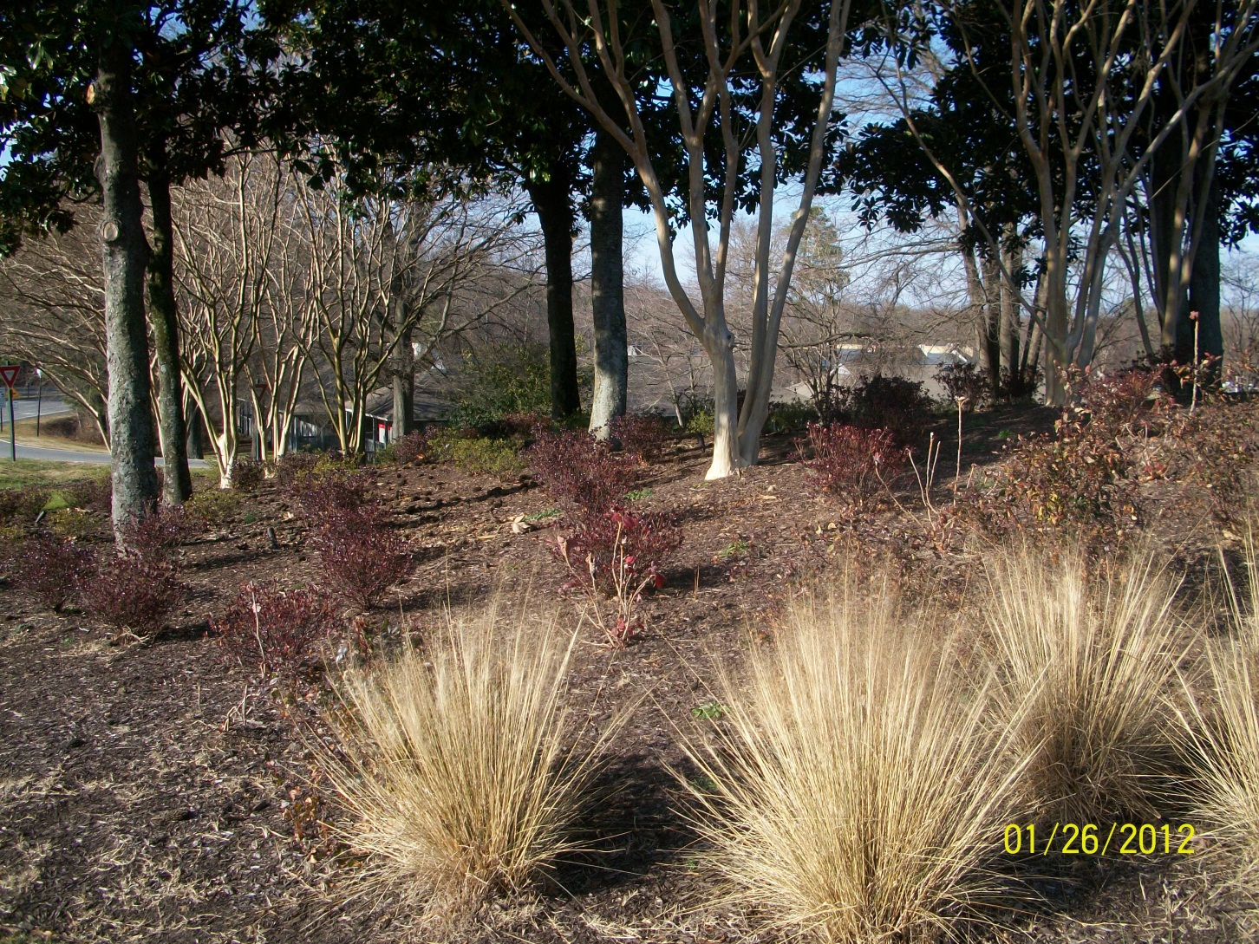
Front Entrance Landscaping

Slide 10
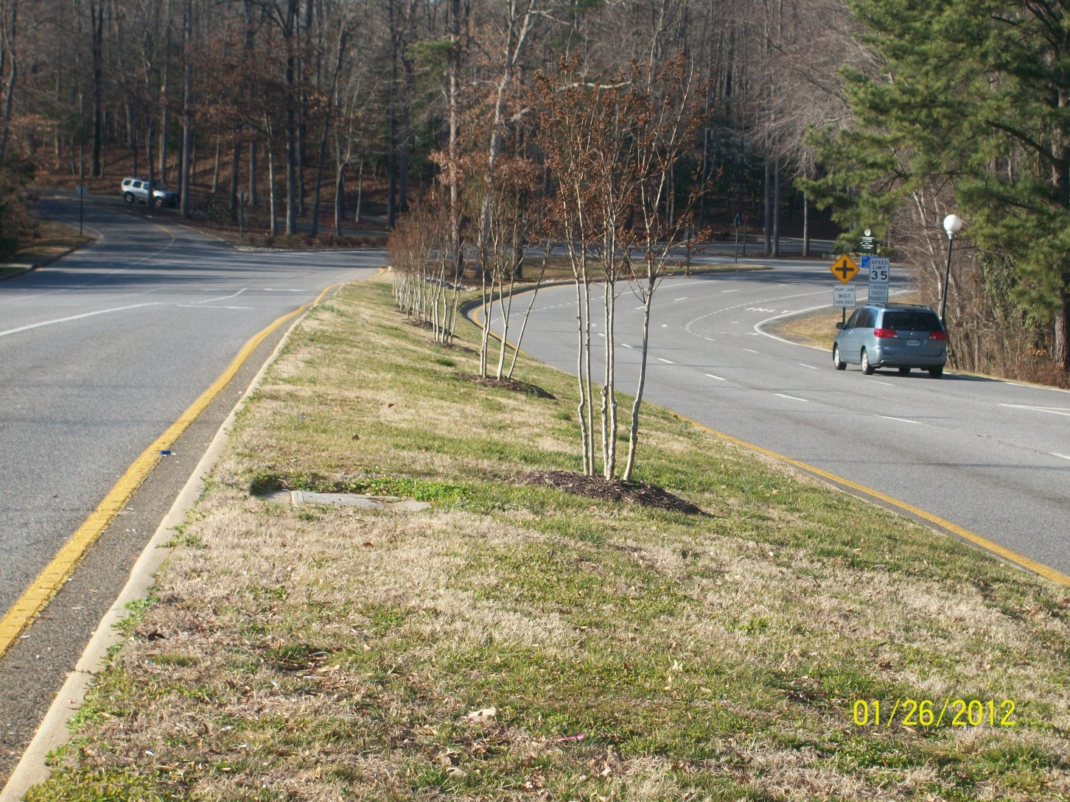
Old Hundred Road median strip
Notes:
Nine Red Rocket Crape Myrtles – replaced Honey Lucust

Slide 11
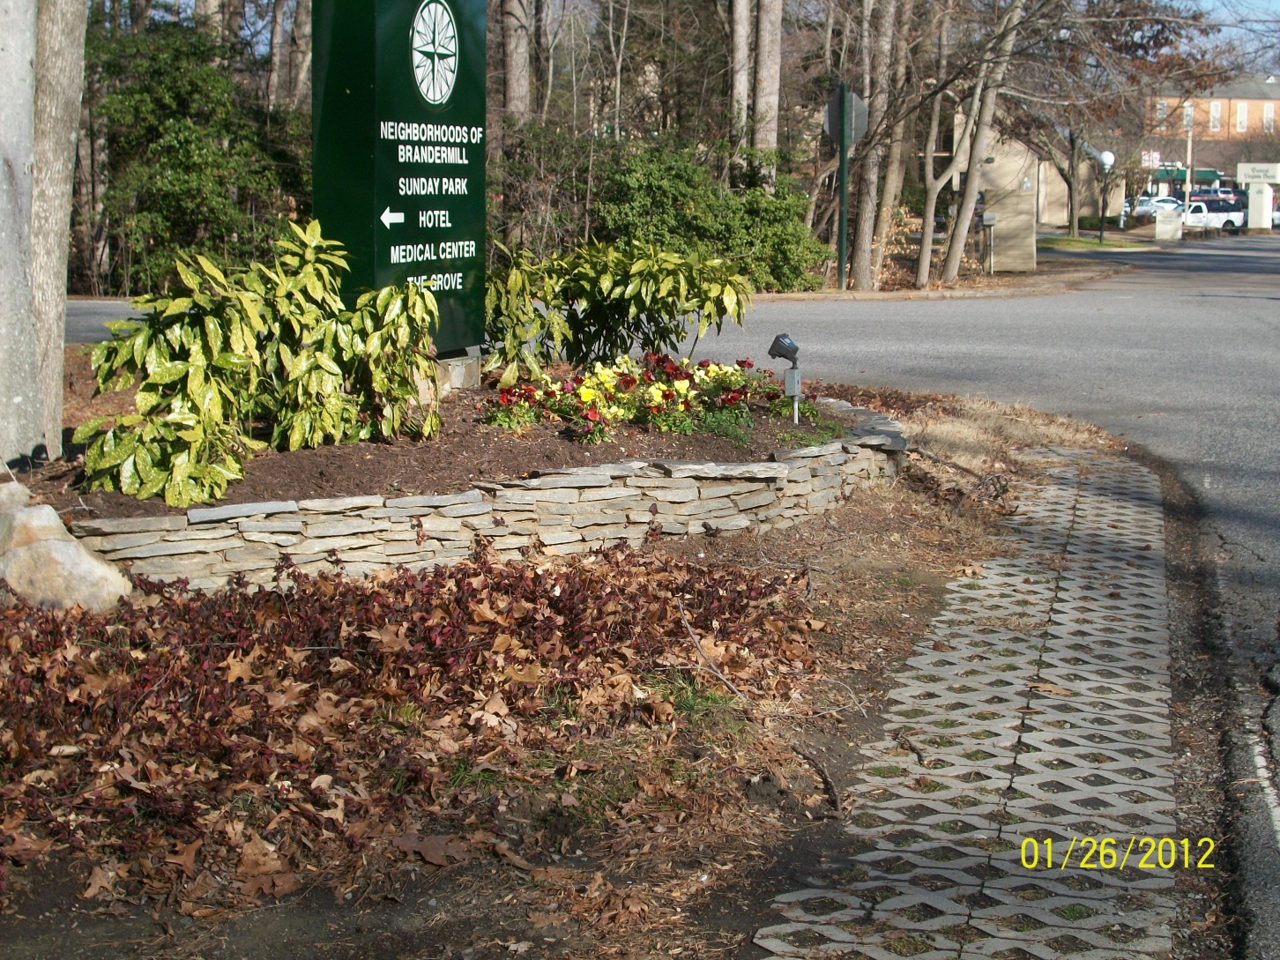
Old Hundred at Millridge Parkway
Notes:
Pavers added to keep road and landscape area separate

Slide 12
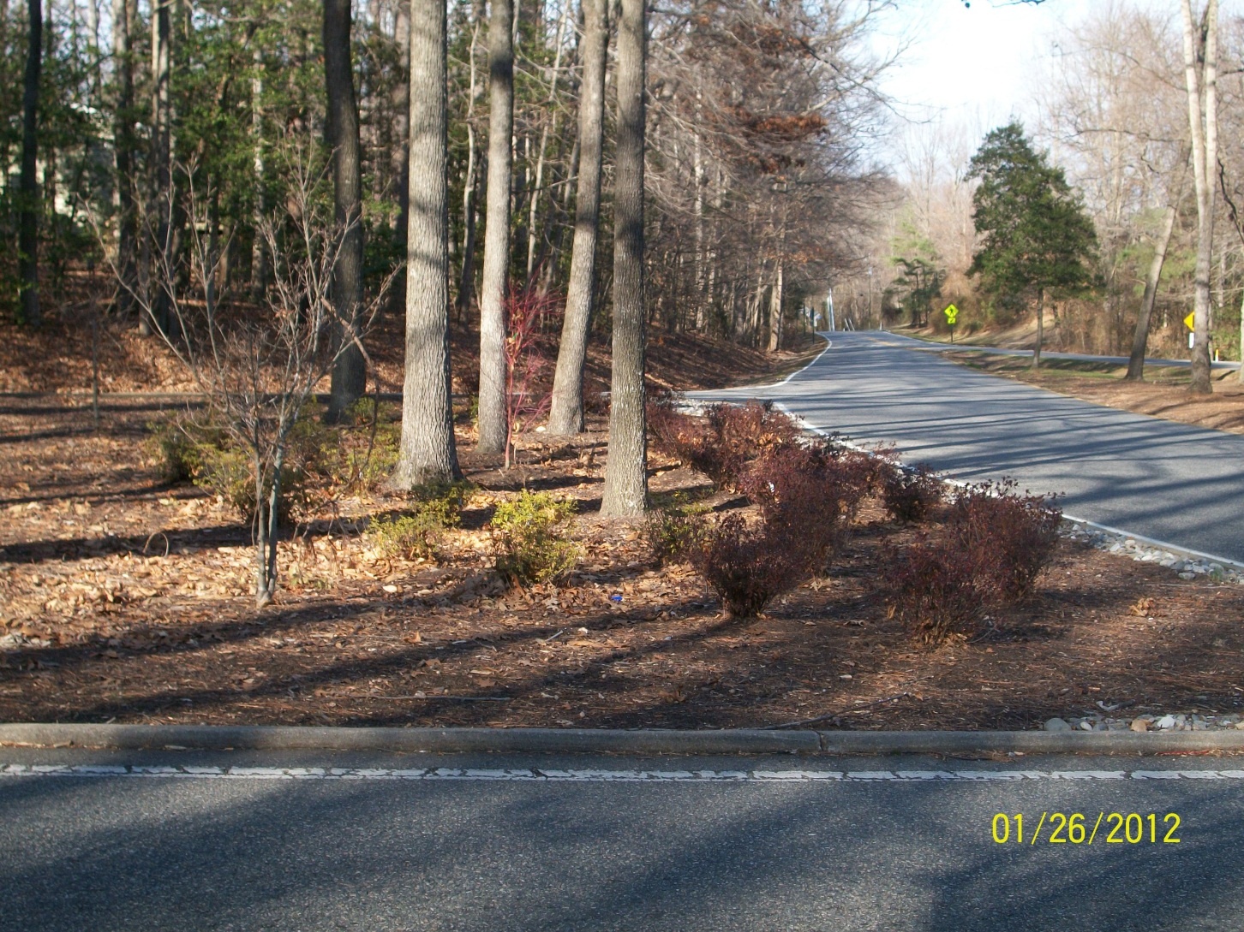
Millridge Parkway entrance
Notes:
Three Islands

Slide 13
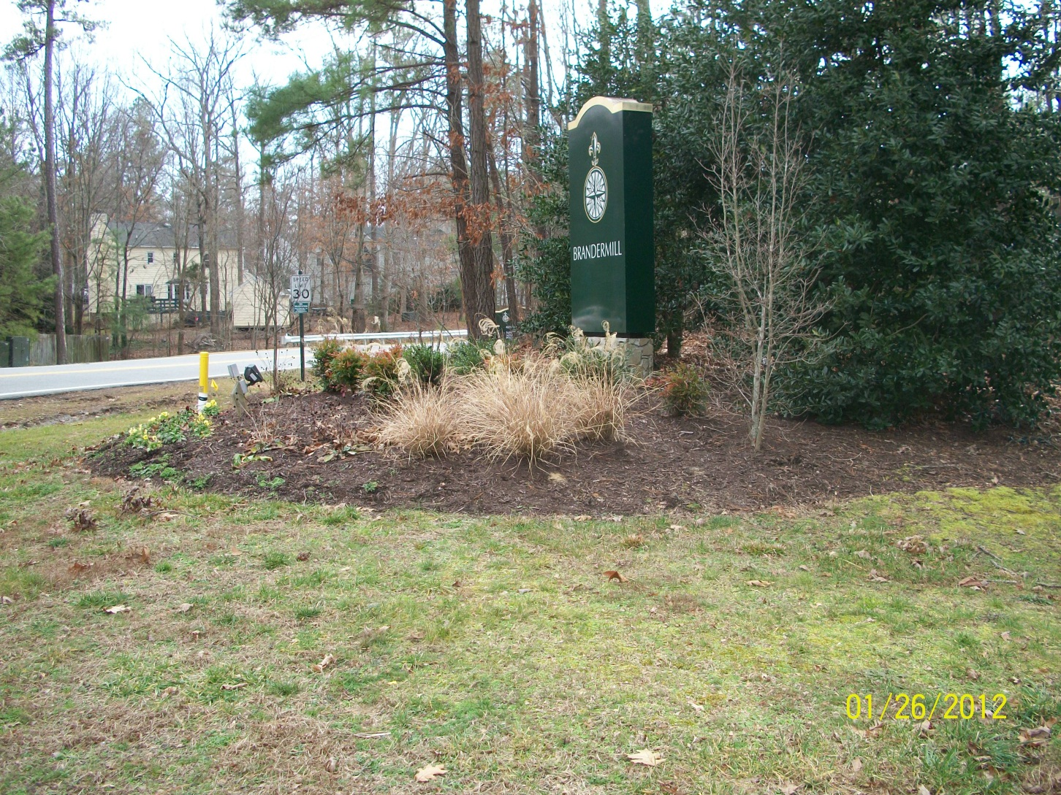
Brandermill Parkway North Entrance

Slide 14
Community Clean Up Day
Activities Committee
Over 35 neighborhoods participated
73 BAGSTERS used for open space clean up
BCA partnered with Waste Management in providing the BAGSTER and coordinating the pick ups.

Slide 15
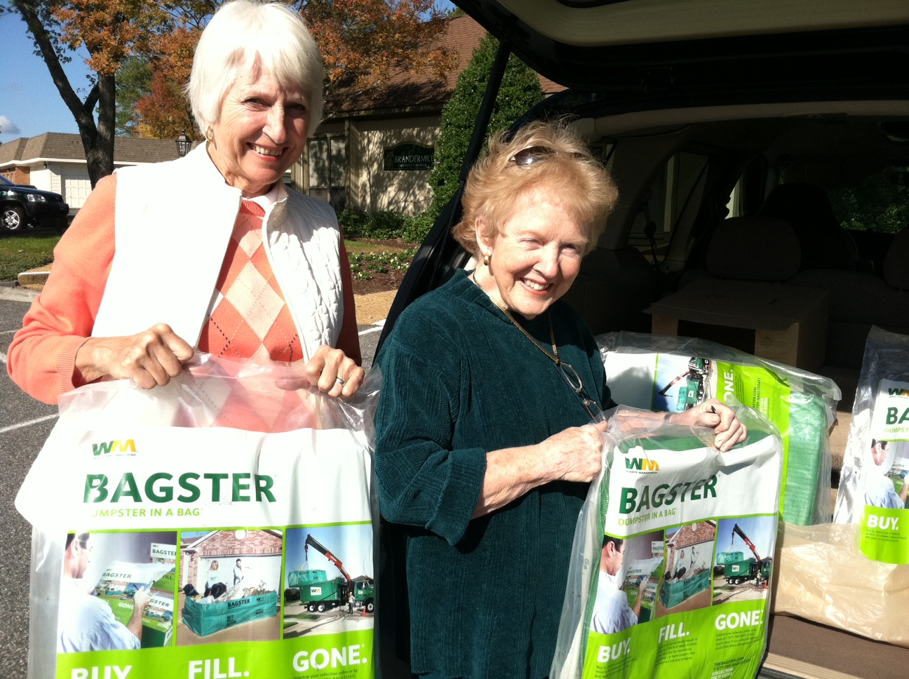
Community Clean Up Day
BAGSTER Pick Up

Slide 16
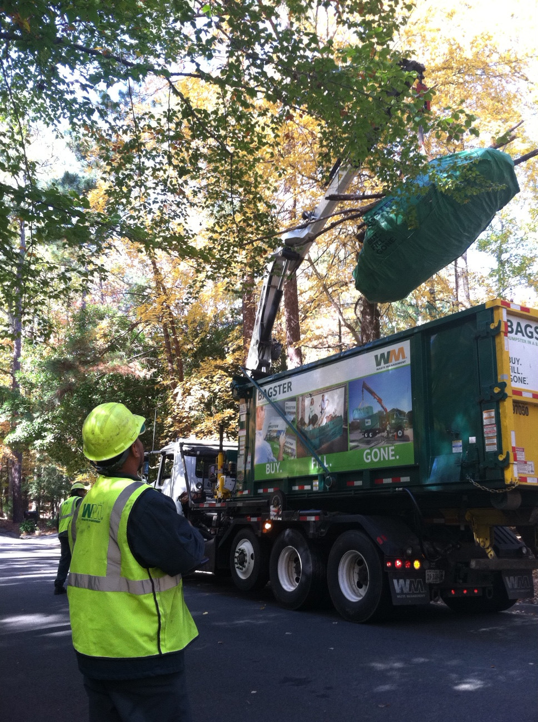
Community Clean Up Day
Waste Management Services
Notes:
Rousing success

Slide 17
The Landing
Natural Resources - lead committee
Other committee participants in the project included:
  Community Character
  Crime Prevention
Project components
  New downcast light globes
  Driveway edging stone work
  Driveway re - grading
  Additional plantings – bathroom area, neighborhood screening
Notes:
Comments have been positive on changes

Slide 18
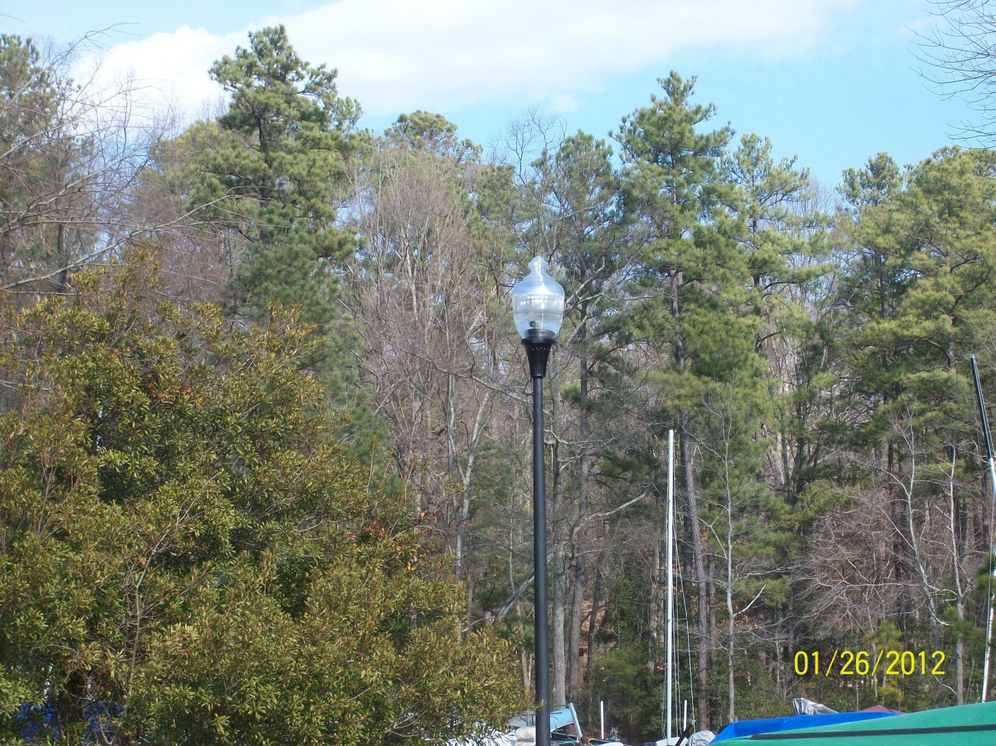
The Landing

Slide 19
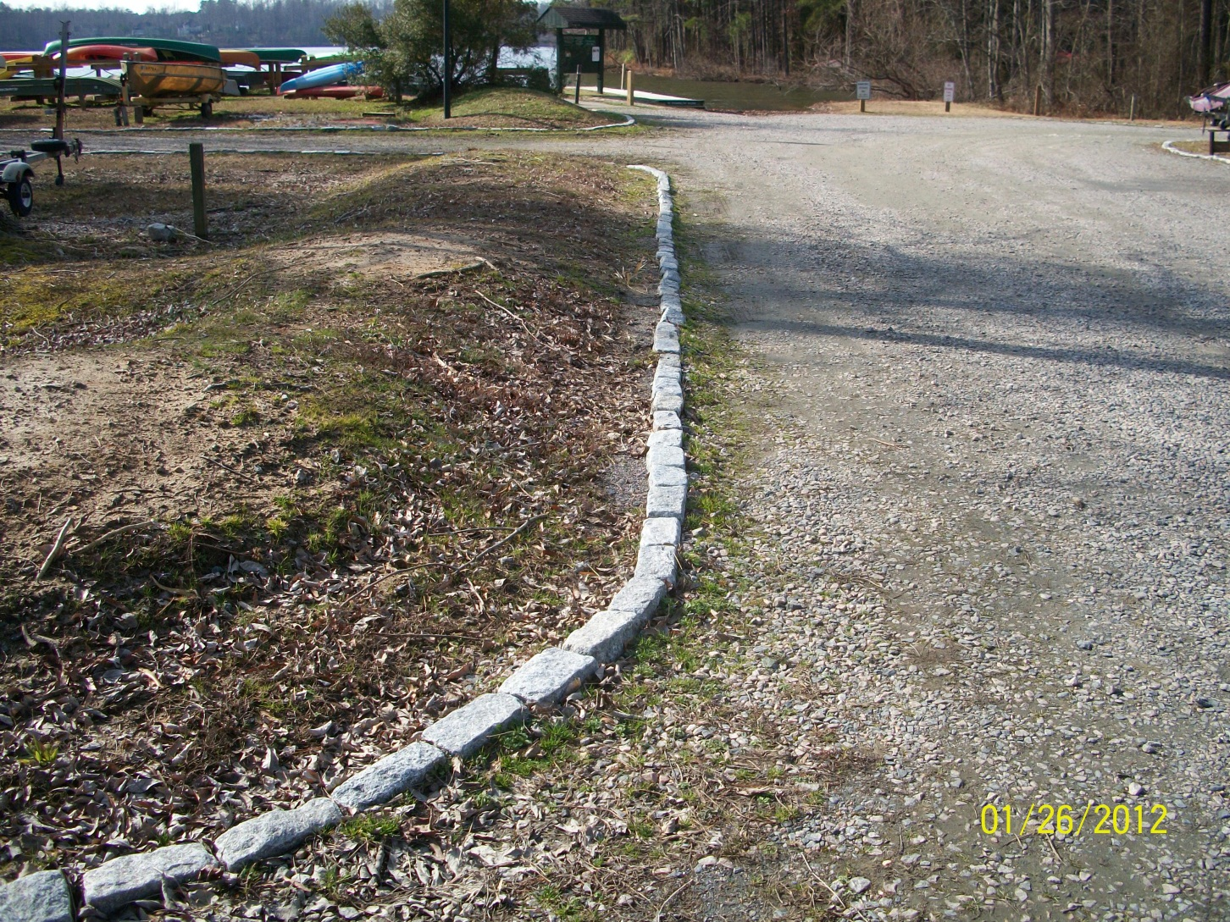
The Landing

Slide 20
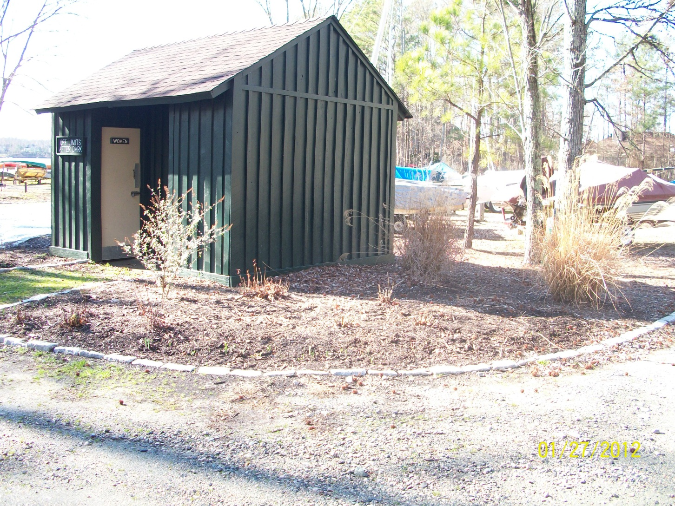
The Landing
Notes:
New plantings

Slide 21
The Landing
Natural Resources Committee
BCA Maintenance Role
  Painting bathroom (Brandermill Green)
  Install boat wash station - back side of bathroom
  Install post and rope near path and water
  Repair and replace bridge, resurface walking path near bridge
  Replace all t - racks (from three tier to two tier )
  Secure driveway edging stone work

Slide 22
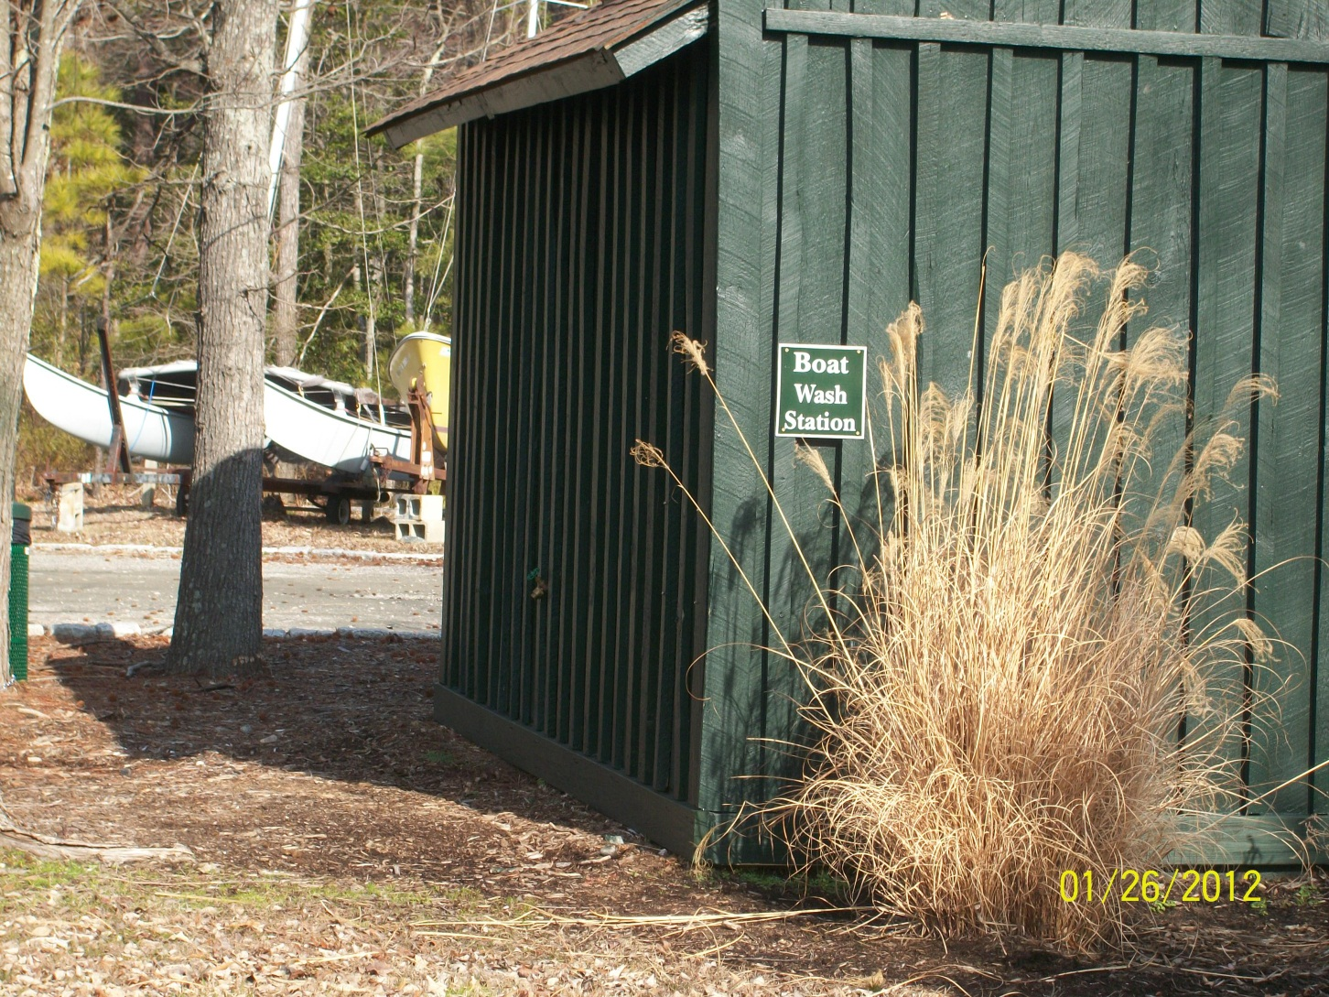
The Landing
Notes:
Brandermill Green – boat wash station hose bib with hose reel, in boating season

Slide 23
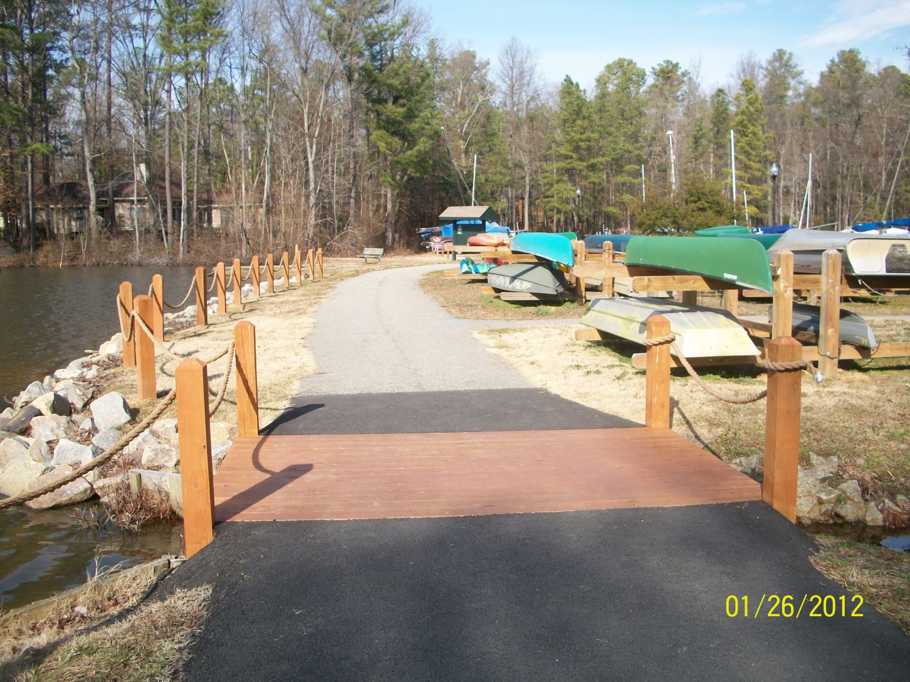
The Landing
Notes:
Post and rope, bridge repair, asphalt smmoting adjacent areas to bridge

Slide 24
Nuttree Park Pavilion
Natural Resources Committee
Responding to feedback from user residents, Committee conceptualizes pavilion and location
Assistance from Architectural Review Board and BCA staff and Maintenance Department
  ARB assists in design development and approves
  Staff works with county on permitting
  BCA Maintenance completes construction (Painting Brandermill Green pending)

Slide 25
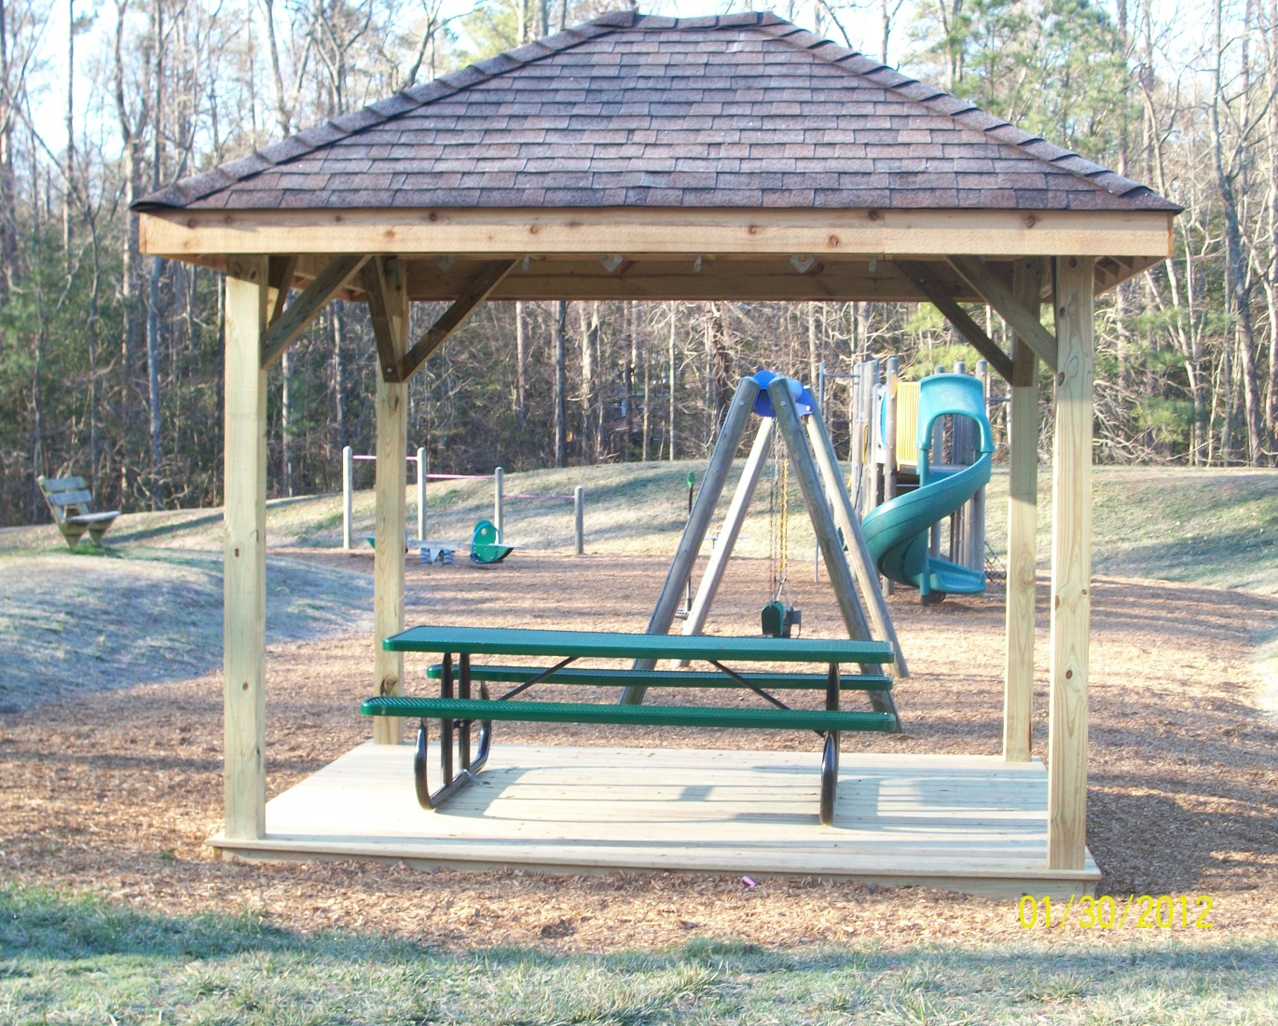
Nuttree Park
Pavilion

Slide 26
North Beach Pocket Park
Facilities Committee
Design picnic area
Gather volunteers for mulch spreading
Review and recommend park entrance signage (pending)
  BCA Master Gardener and BCA Maintenance add assistance
    Submit mitigation plans to county
    Plant shrubs required to receive permit
    Clear path and picnic area
    Install split rail fence

Slide 27
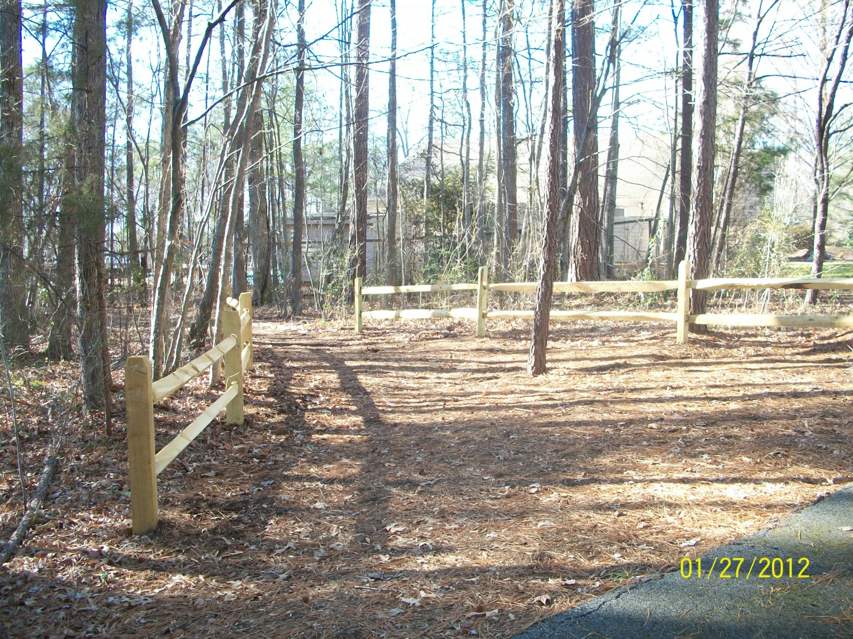
North Beach Pocket Park
Notes:
Entrance area near Shallowford Landing path

Slide 28
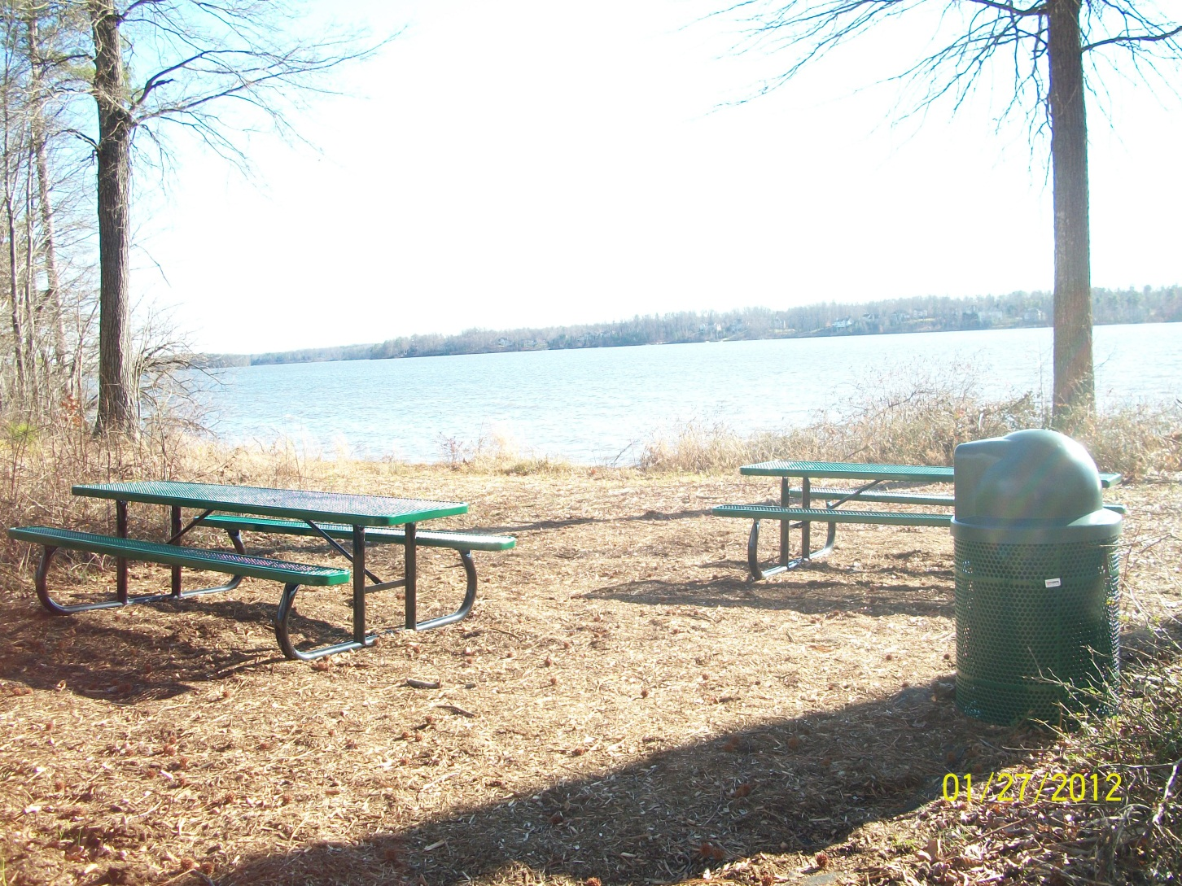
North Beach Pocket Park
Notes:
Beautiful spot

Slide 29
Trail Review
Facilities Committee
Committee members compare existing Brandermill map to actual trail
Report findings to BCA for use by
A. BCA Maintenance for repair work (on going)
B. BCA staff to update maps (in progress)

Slide 30
Cluster Mail Boxes
Neighborhood Residence Council (NRC) and ARB
New design for cluster boxes in multi family neighborhoods
  NRC receives resident suggestions and feedback for design and implementation plans
  ARB works with NRC and contractor in design development and approval

Slide 31
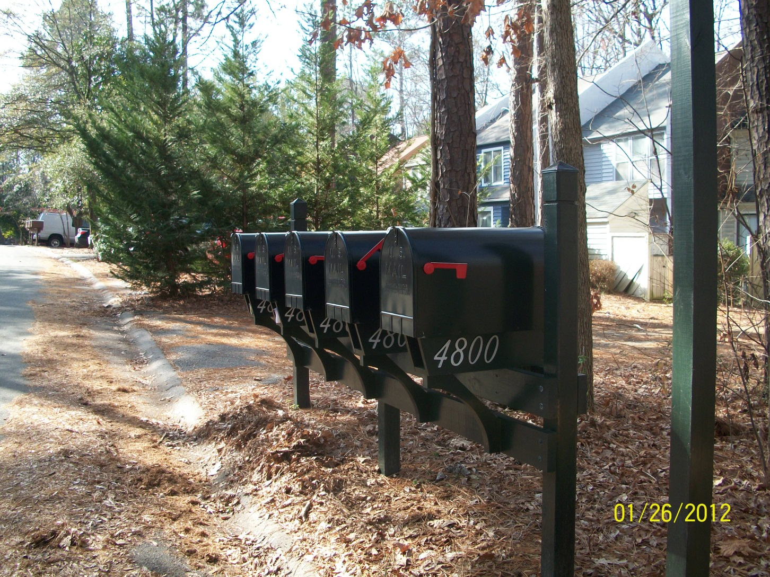
Cluster Mail Boxes

Slide 32
Harbour Pointe Clubhouse interior upgrades – BCA
New carpet
New kitchen tile flooring
New counter tops
New furniture

Slide 33
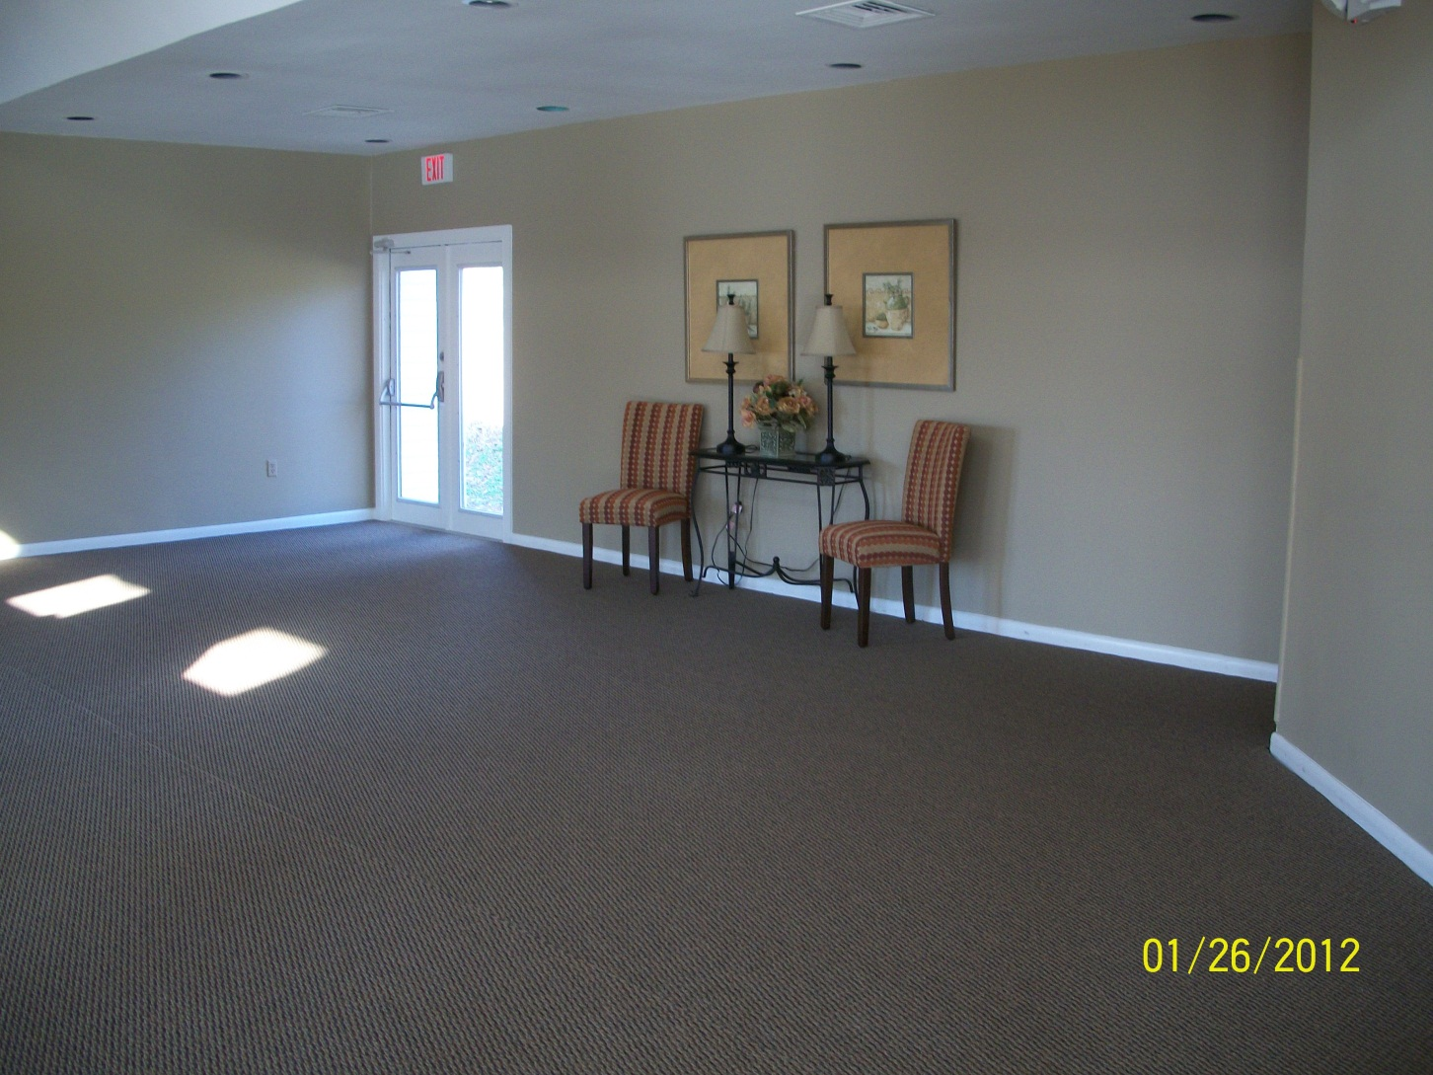
Harbour Pointe Clubhouse

Slide 34
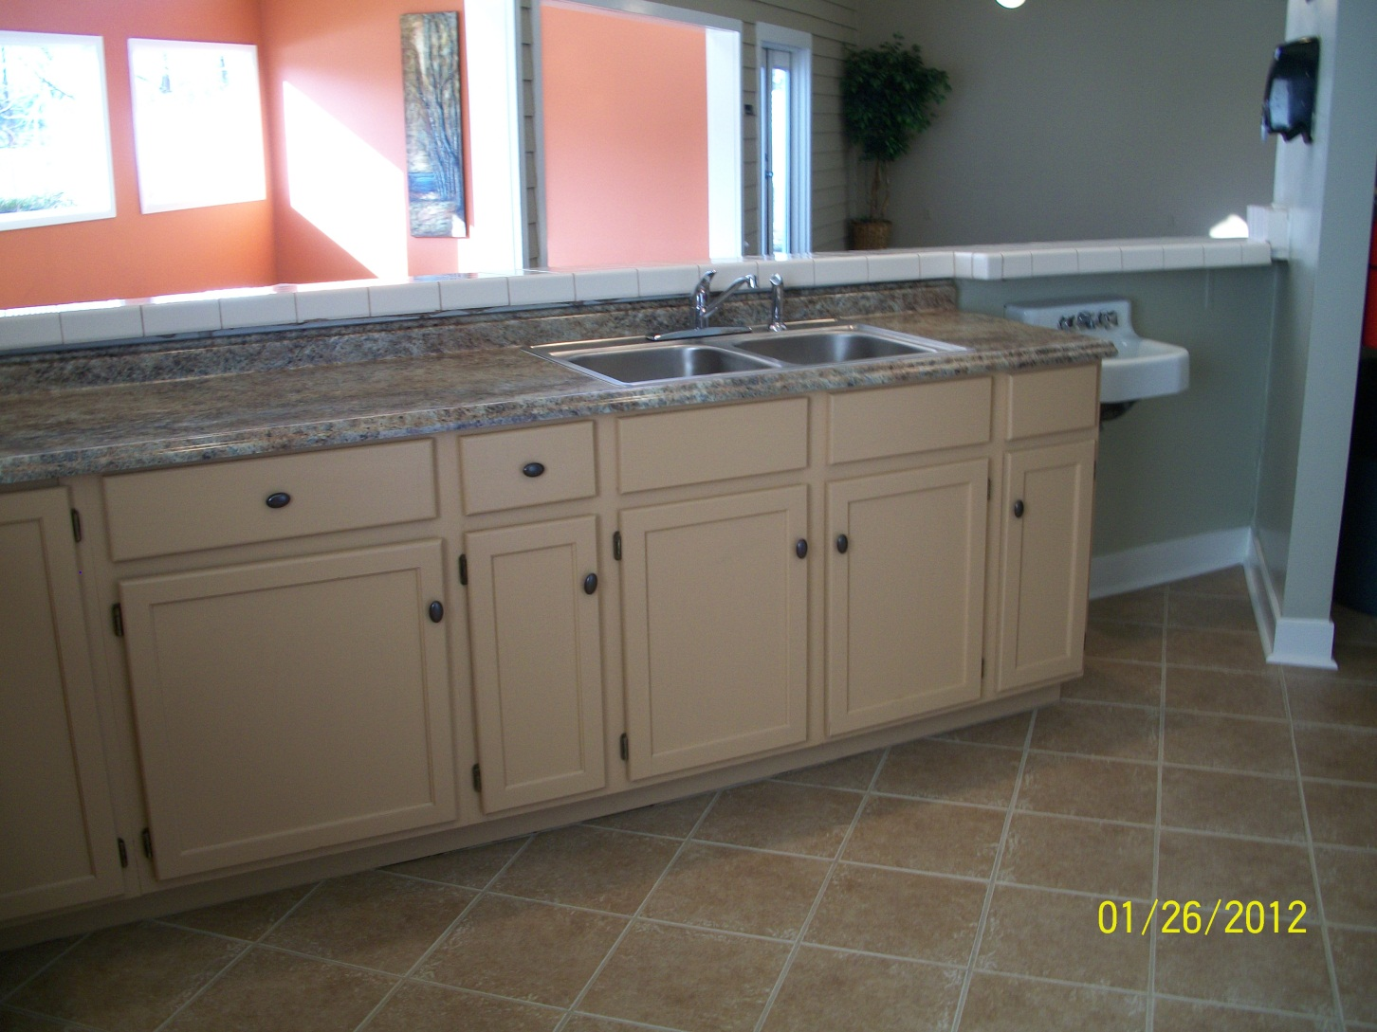
Harbour Pointe Clubhouse

